Slide 1
Lab 12: Hybridization and Introgression
BIOL4174/5174 Conservation Genetics Spring 2018
Tyler Chafin

Slide 2
Using SNP site-pattern discordance to test for introgression
Classifying hybrids
Signals of RI, adaptive introgression, selection

Slide 3
Hybridization = Interbreeding of individuals from two distinct gene pools
Introgression = Exchange of alleles (via hybridization and backcrossing) from one distinct entity to the gene pool of another
i.e. gene flow between species/ divergent populations

Slide 4
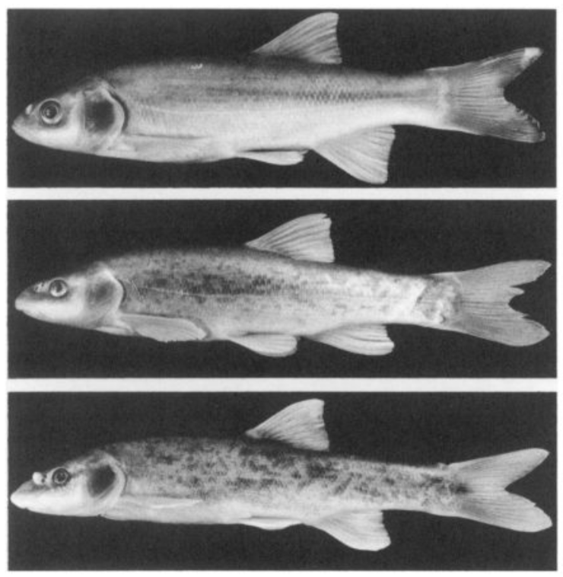
Classically considered to result in intermediate morphology… Likely most apparent in F1 gen

Slide 5
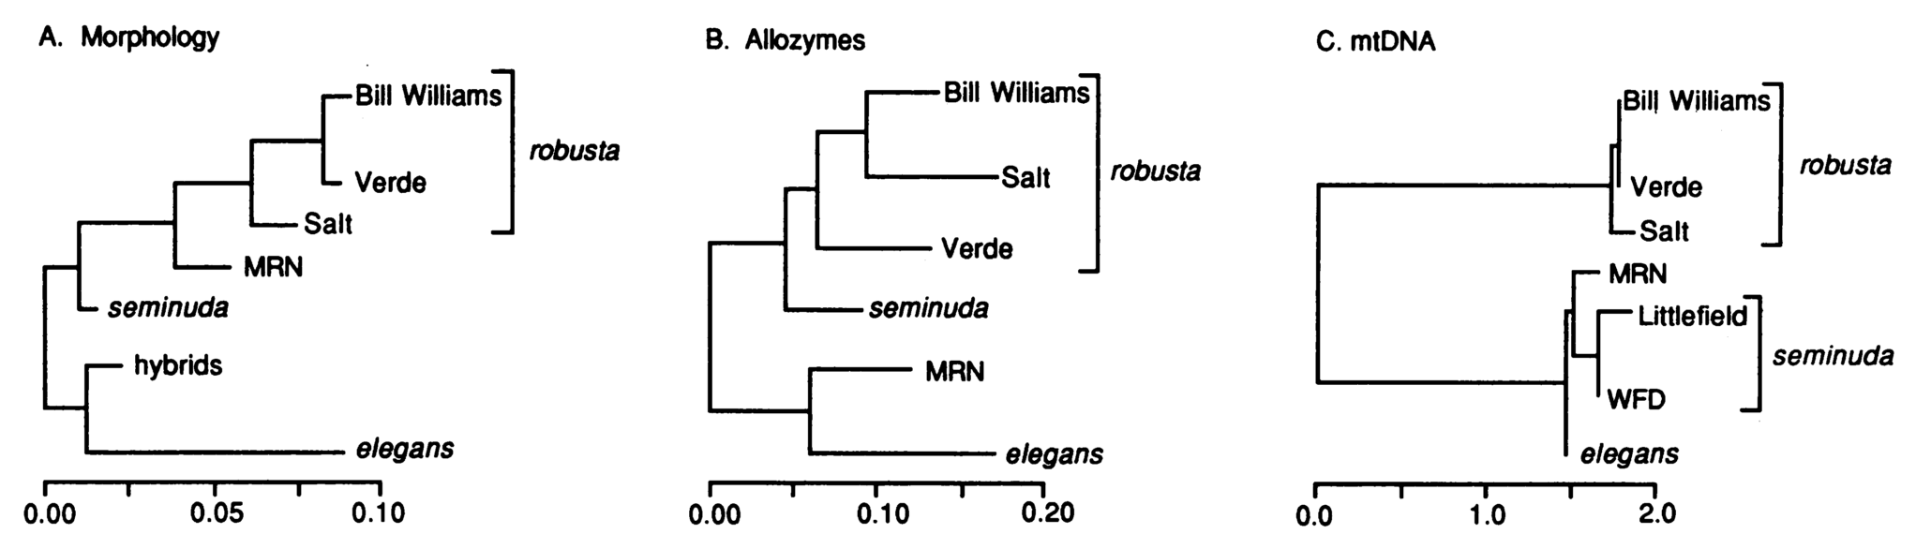
Most genetic approaches use ‘genealogical conflict’ as evidence for introgressive hybridization
robusta
elegans
seminuda
+
=

Slide 6
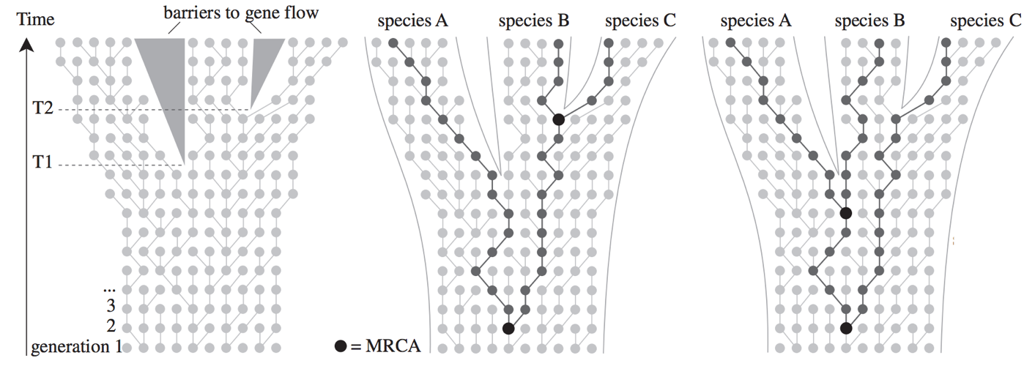
But gene-tree discordance can also result from stochastic allele sorting during discordance
A
A
B
B
C
C

Slide 7
Using SNP site-pattern discordance to test for introgression

Slide 8
The ubiquity of incomplete lineage sorting makes introgression difficult to identify…

Slide 9
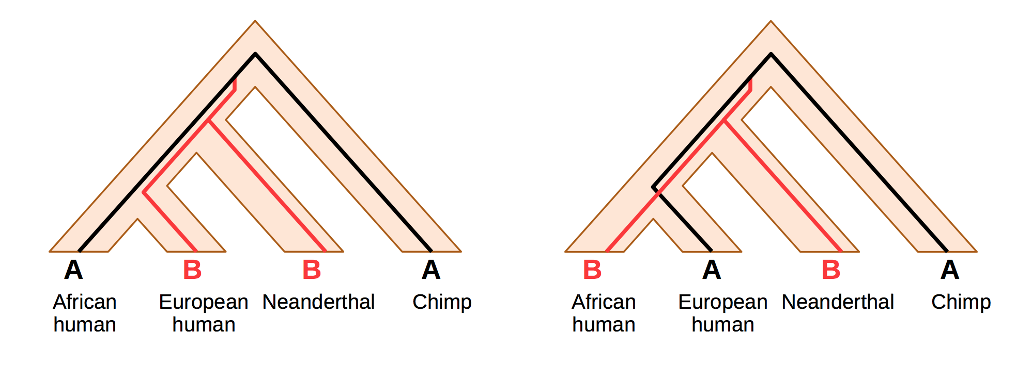
Expectation under ILS:
50% ABBA
50% BABA

Slide 10
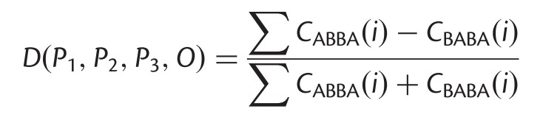
Expectation under ILS:
50% ABBA
50% BABA

Slide 11
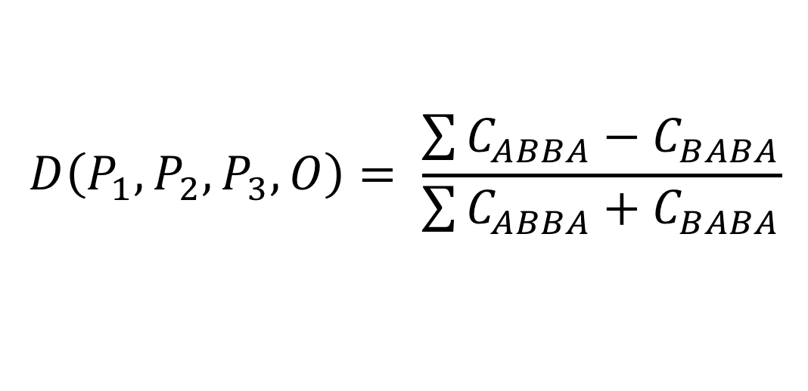
$$D\left(P_{1},P_{2},P_{3},O\right)= \frac{\sum{C_{ABBA}−C_{BABA}}}{\sum{C_{ABBA}+C_{BABA}}}$$

Slide 12
Add up the difference in site patterns across loci
$$D\left(P_{1},P_{2},P_{3},O\right)= \frac{\sum{C_{ABBA}−C_{BABA}}}{\sum{C_{ABBA}+C_{BABA}}}$$

Slide 13
Divided by total discordant site patterns
$$D\left(P_{1},P_{2},P_{3},O\right)= \frac{\sum{C_{ABBA}−C_{BABA}}}{\sum{C_{ABBA}+C_{BABA}}}$$

Slide 14
+D = excess of ABBA sites

Slide 15
+D = excess of ABBA sites
-D = excess of BABA sites

Slide 16
+D = excess of ABBA sites
-D = excess of BABA sites
Either could happen due to sampling finite number of sites… Need to test if deviation from 50%/50% significant.

Slide 17
+D = excess of ABBA sites
-D = excess of BABA sites
Either could happen due to sampling finite number of sites… Need to test if deviation from 50%/50% significant.
Z-score
Bootstrapping or Jacknifing

Slide 18
Fundamentally, the D-statistic assumes parsimony
It can be wrong when evolution does not occur parsimoniously

Slide 19
Problems with D-statistic
0
0→1
P1
P2
P3
O
0
1
1
0
A
B
B
A

Slide 20
Problems with D-statistic
0
The D-statistic assumes evolution occurs parsimoniously
0→1
0→1
P1
P2
P3
O
0
1
1
0
A
B
B
A
False positive

Slide 21
Problems with D-statistic
0
0→1
The D-statistic assumes evolution occurs parsimoniously
0→1
P1
P2
P3
O
1
0
0
1
A
B
B
A
False positive

Slide 22
Problems with D-statistic
0
0→1
Rate heterogeneity can cause excess ABBA or BABA
0→1
P1
P2
P3
O
0
1
1
0
A
B
B
A
False positive

Slide 23
Problems with D-statistic
0
0→1
Assumes no mutation after introgression
1→0
P1
P2
P3
O
0
1
0
0
A
B
A
A
False negative

Slide 24
Using SNP site-pattern discordance to test for introgression
Classifying hybrids
Using patterns of SNP frequency across hybrid genomes to infer patterns of RI, selection, adaptive introgression

Slide 25
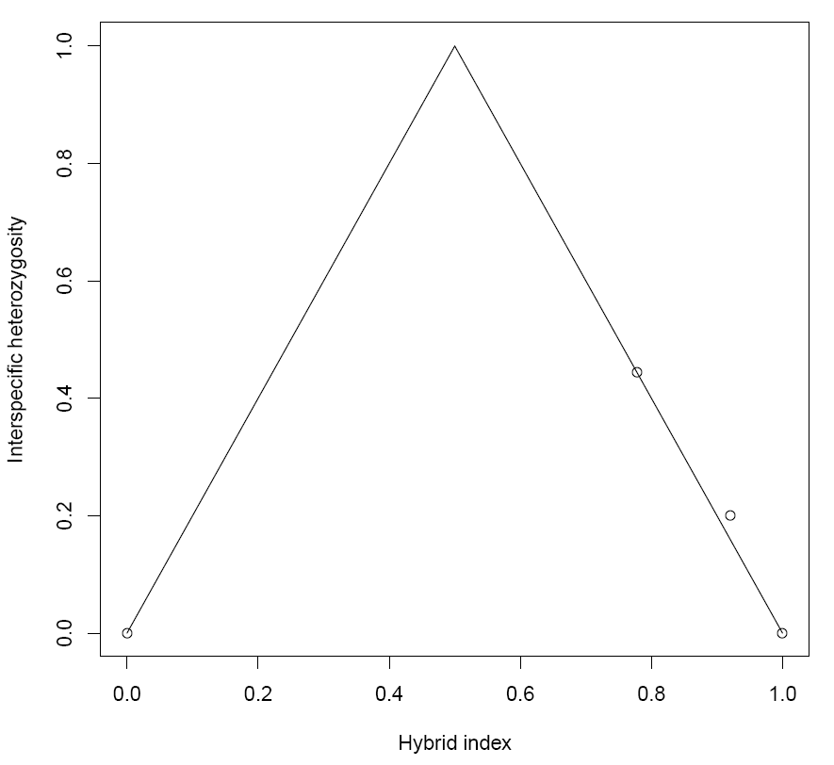
Hybrid index = Proportion of genome assigned to P2
Interspecific Heterozygosity
Hybrid Index
Notes:
25

Slide 26
F1
Interspecific Heterozygosity
P1
P2
Hybrid Index
Notes:
26

Slide 27
B0
B1
Interspecific Heterozygosity
F2
Hybrid Index
Notes:
27

Slide 28
Software
R packages Introgress and Hiest: Likelihood estimation of hybrid index and interspecific heterozygosity
NewHybrids: Model-based assignment test, sort of like Structure

Slide 29
Using SNP site-pattern discordance to test for introgression
Classifying hybrids
Signals of RI, adaptive introgression, selection

Slide 30
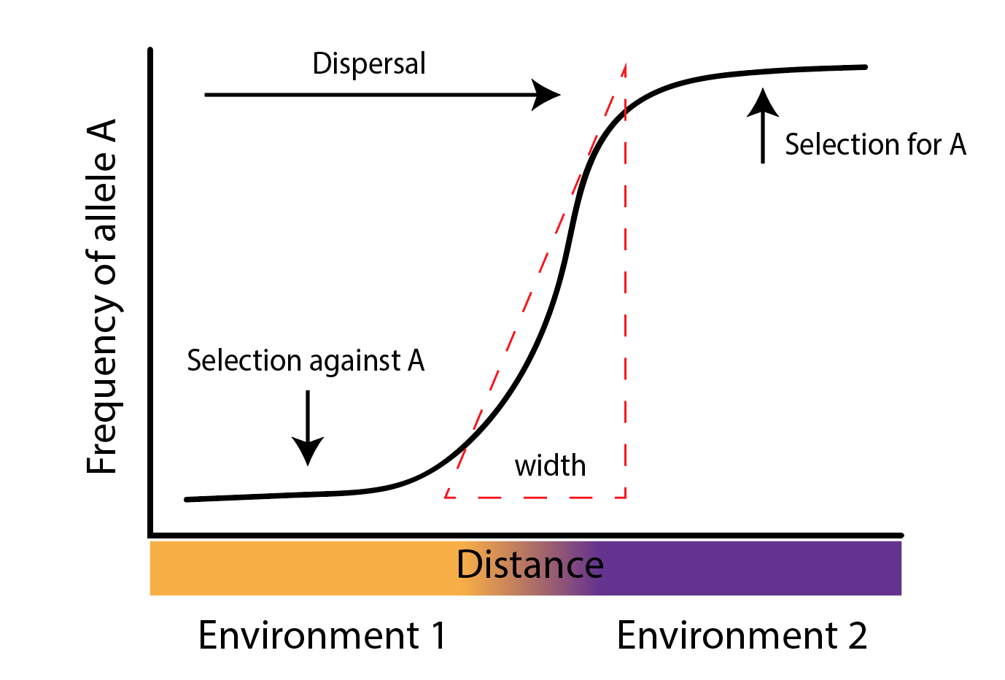
Cline theory – Selection/migration balance

Slide 31
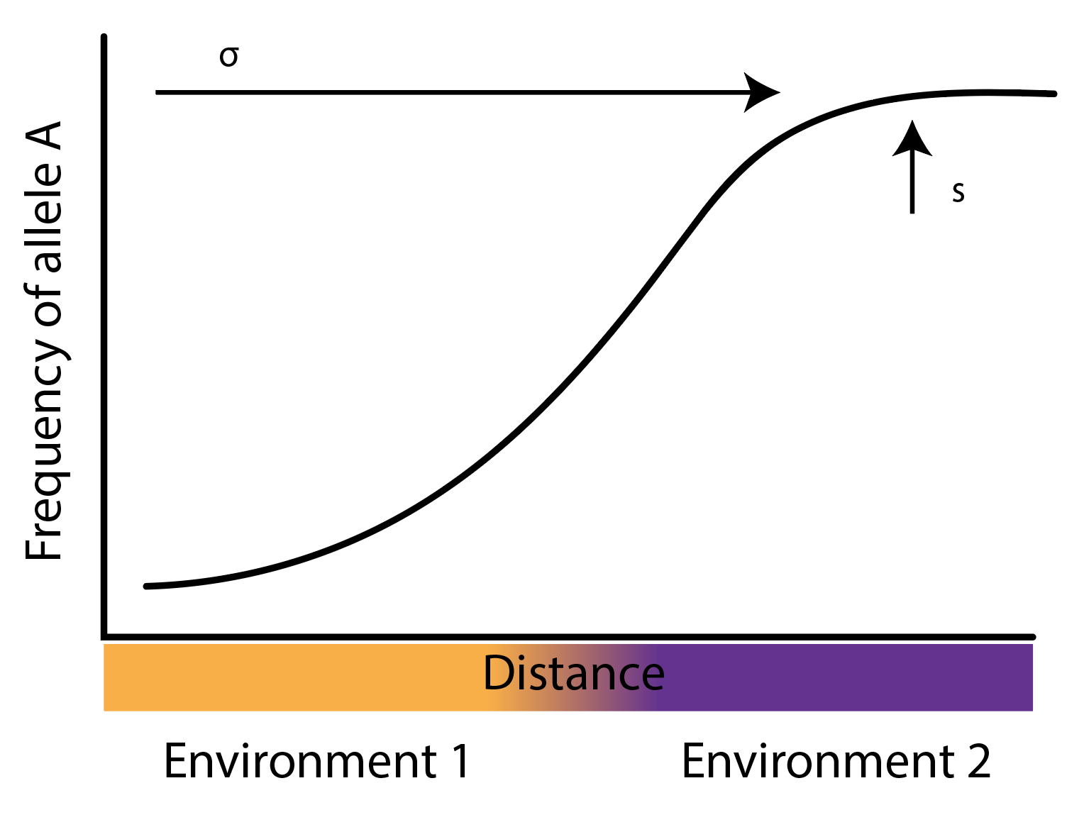
Cline width: Dispersal

Slide 32
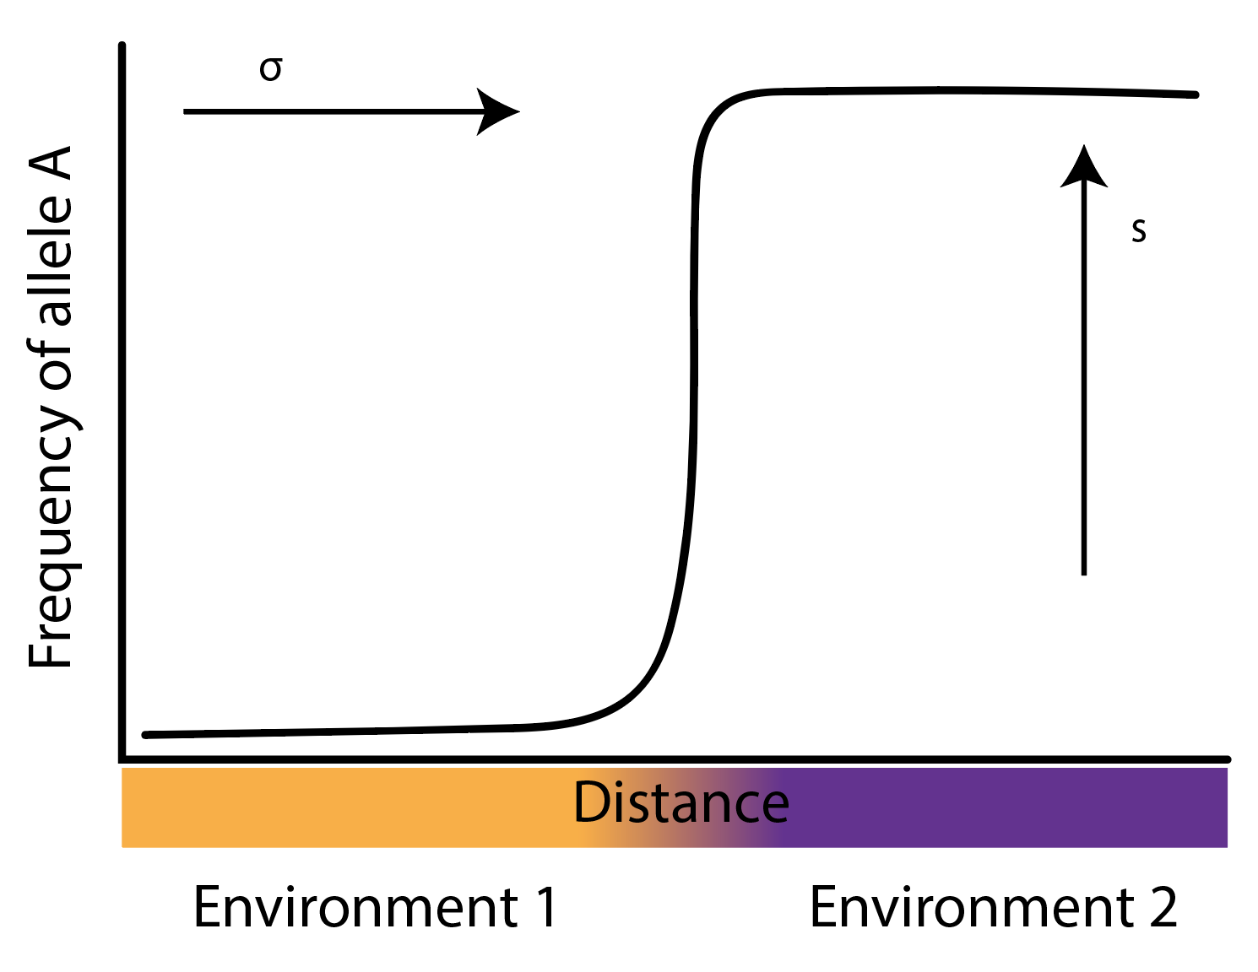
Cline width: Selection

Slide 33
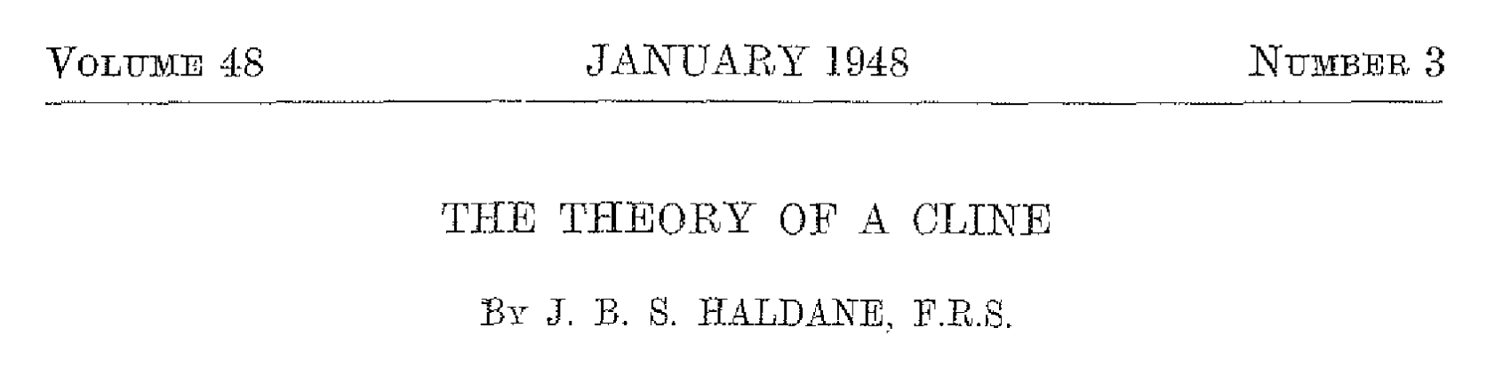
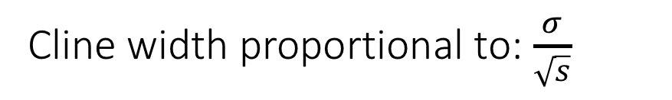
Cline width proportional to: $\frac{σ}{\sqrt{s}}$

Slide 34
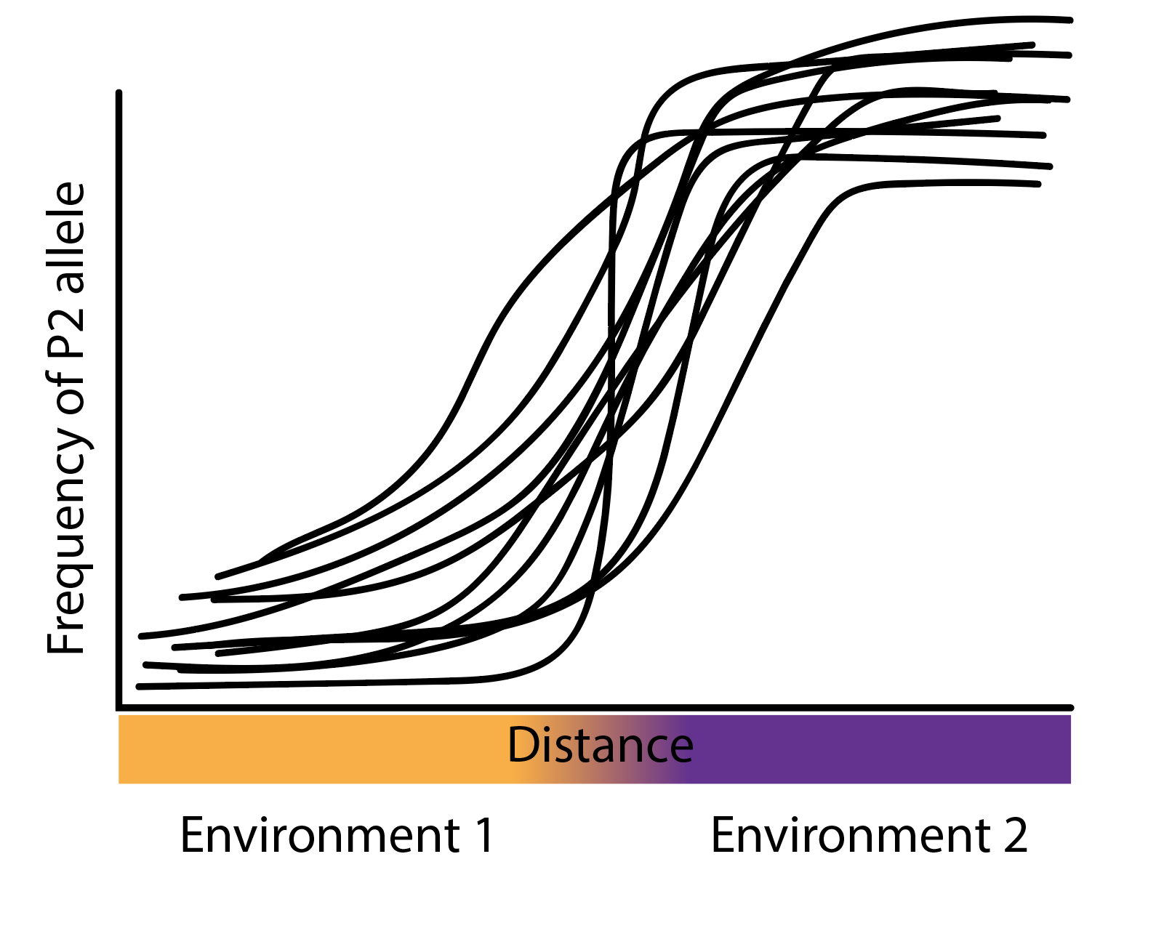
Multi-locus clines in a hybrid zone: Cline coincidence

Slide 35
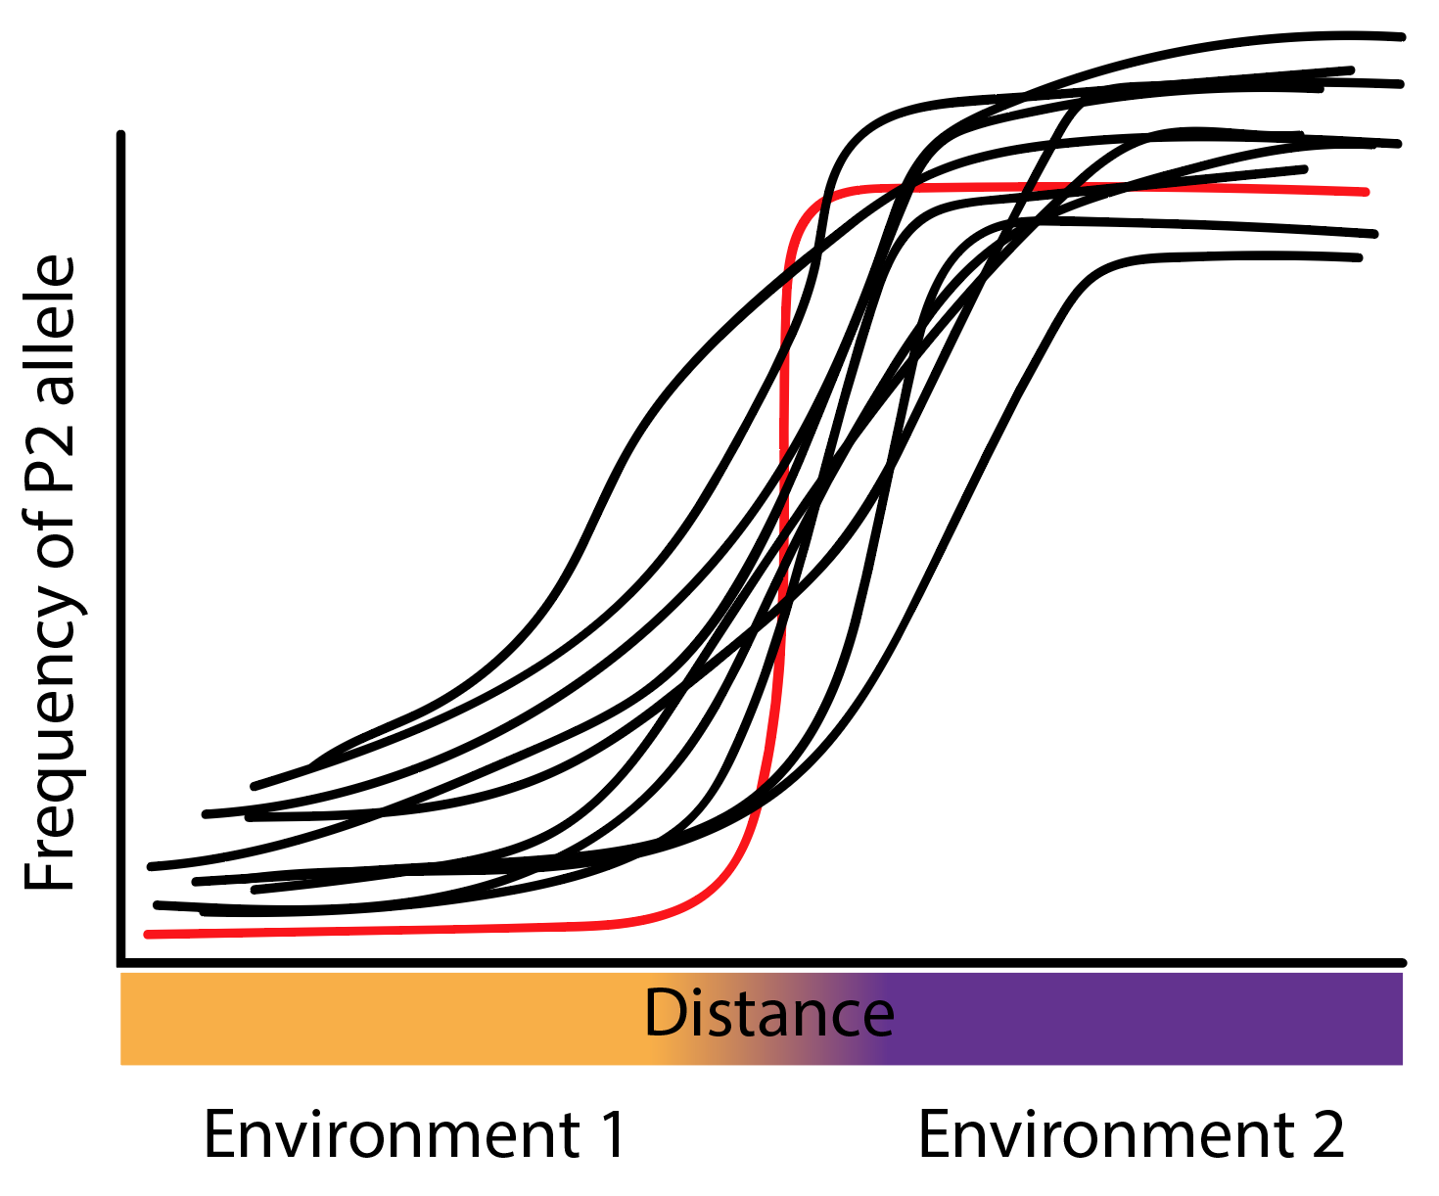
Selection against heterozygotes?

Slide 36
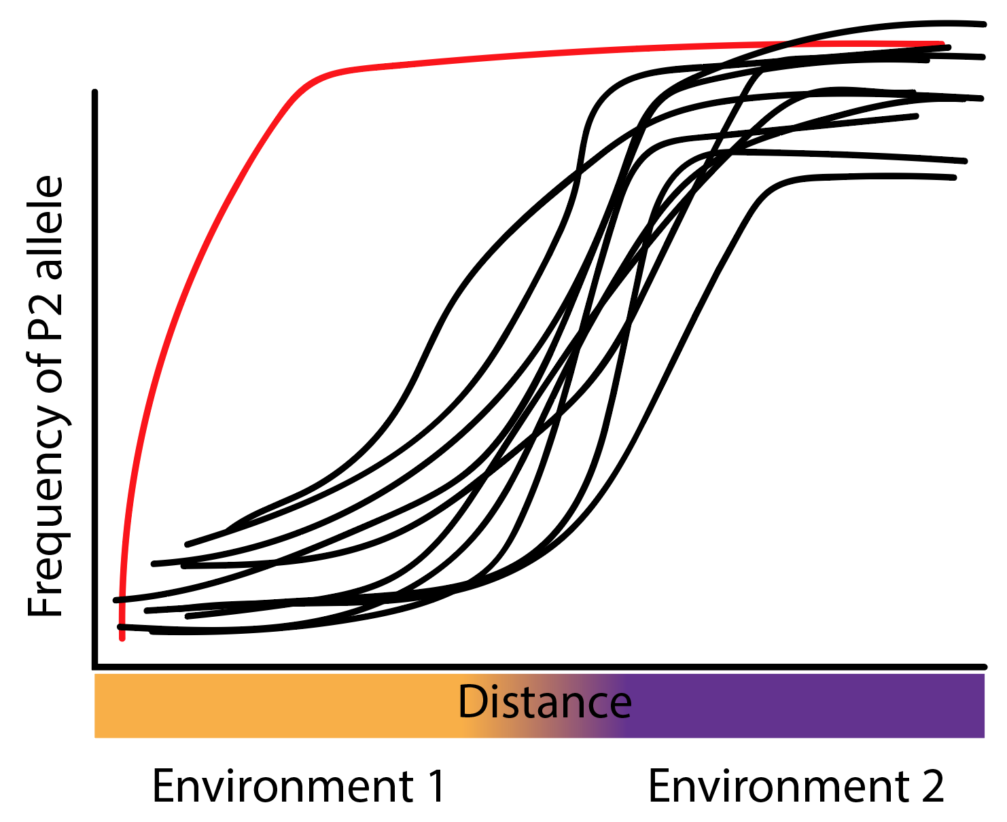
Adaptive introgression?

Slide 37
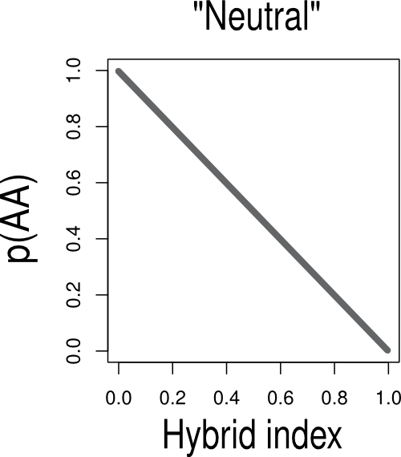
Genomic clines
X-axis: “Hybrid index”
1.0 = Pure P2
0.0 = Pure P1
Y-axis: “per locus genotype”
All 1.0 = All hybrids have P1 allele
All 0.0 = All hybrids have P2 allele
Genotype Frequency

Slide 38
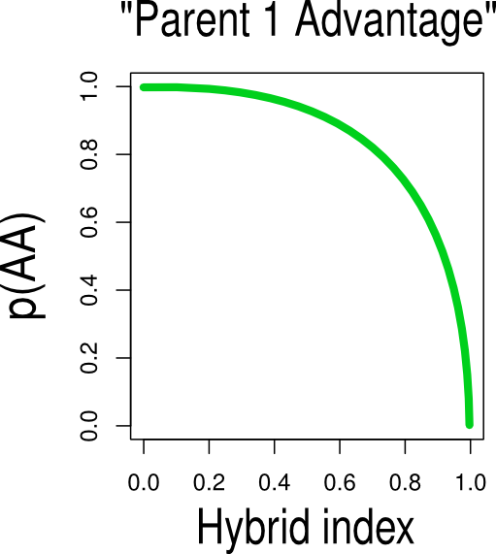
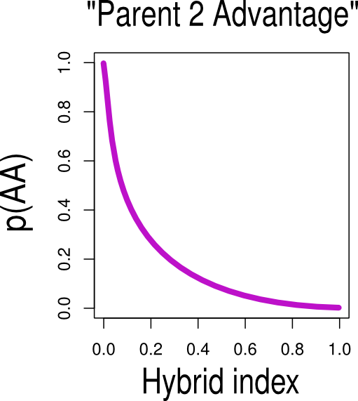
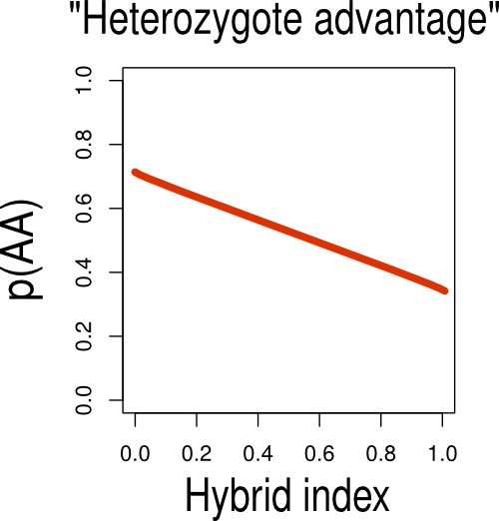
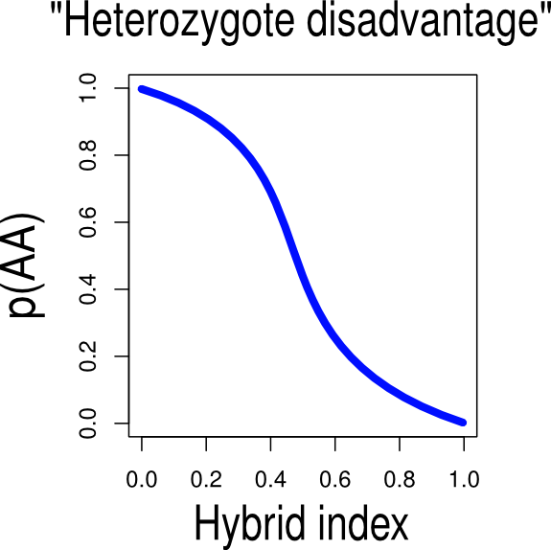
Genotype Frequency
Genotype Frequency
Genotype Frequency
Genotype Frequency
Genotype Frequency
Notes:
38

Slide 39
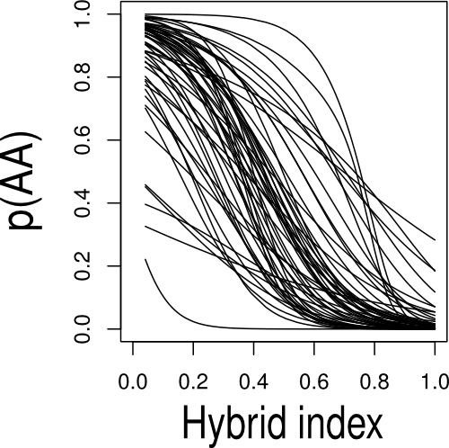
Genotype Frequency

